Slide 1
MY MODULES 1. DATASET COLLECTION 2. EXPLORATORY DATA ANALYSIS 3. DATA PRE-PROCESSING
DIABETES PREDICTION USING MACHINE LEARNING
V . RENITA
2019506073

Slide 2
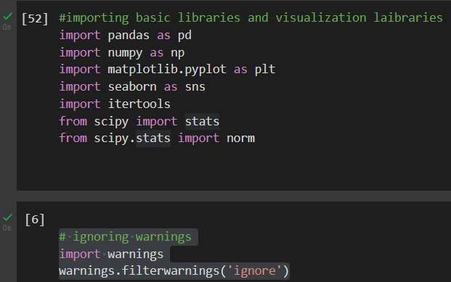
IMPORTING LIBRARIES :
Libraries Used:
1. Numpy stands for numerical python - is used for including any type of mathematical operation in the code. It is the fundamental package for scientific calculation in Python. It also supports to add large, multidimensional arrays and matrices
2. Pandas - (for data manipulation) which is one of the most famous Python libraries and used for importing and managing the datasets. It is an open-source data manipulation and analysis library.
3. Matplotlib - (for data visualization ) which is a Python 2D plotting library, and with this library, we need to import a sub-library pyplot. This library is used to plot any type of charts in Python for the code
4. Seaborn - (for data visualization)
5. Scikit-learn - (for data modeling)

Slide 3
GET THE DATASET
The collected data for a particular problem in a proper format is known as the dataset.
To use the dataset in our code, we usually put it into a CSV file.
What is a CSV File?
CSV stands for "Comma-Separated Values" files; it is a file format which allows us to save the tabular data, such as spreadsheets
Dataset info :
The diabetes data set was originated from pima Indian diabetes .
Read the csv file using read_csv() function of pandas library and referred to "comma-separated values"

Slide 4
EXPLORATORY DATA ANALYSIS :
Exploratory Data Analysis refers to the critical process of performing initial investigations on data
PURPOSE :
The main purpose of EDA is to help look at data before making any assumptions
EXAMPLES :
Shape – counts the no of rows and columns
keys () – print the column names
Info () – checking the types of data
Describe () - calculating mean , max and std…..
Shape

Slide 5
Keys ()
Info ()
The dataset contains 768 rows of records and 9 columns of attributes.
The data types of the attributes consist of 1 quantitative discrete binary, 6 quantitative discrete numerical integers, and 2 quantitative continuous numerical float with 64 digit placings.
The memory space usage is at least 54.1 kilobytes (KB)

Slide 6
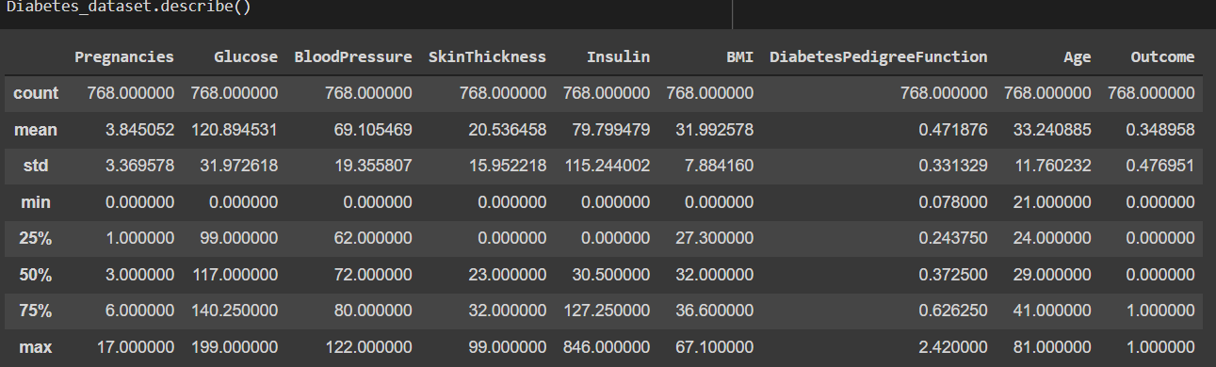
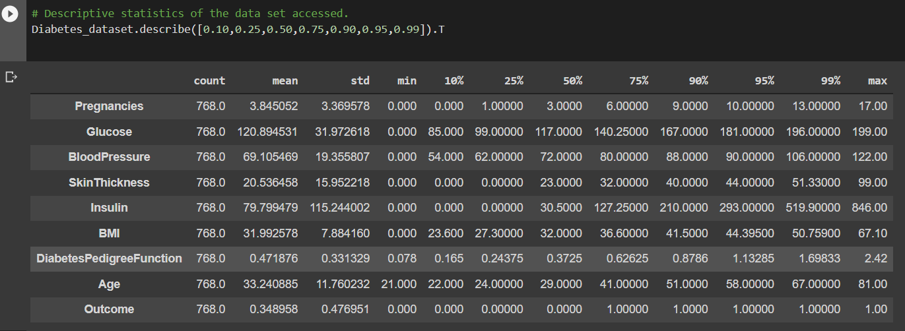
describe ()
count, mean, standard deviation, minimum and maximum values and
describe ().T
T property is used to transpose index and
columns of the data frame.
Syntax: Diabetes_dataset.describe([0.10,0.25,0.50,0.75,0.90,0.95,0.99]).T

Slide 7
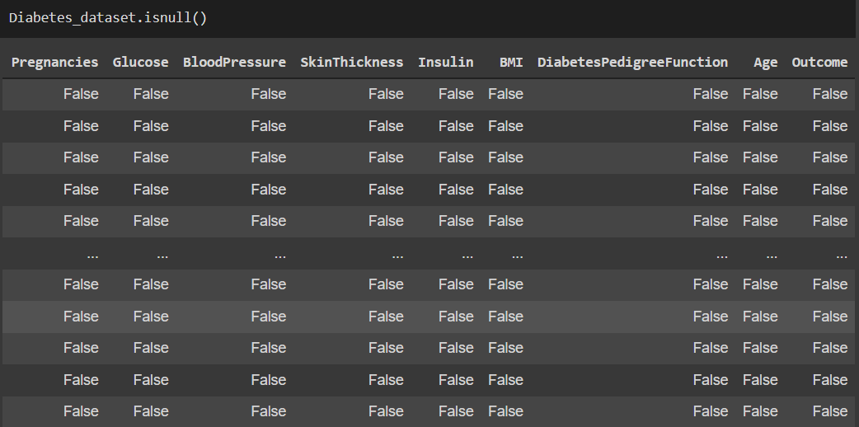
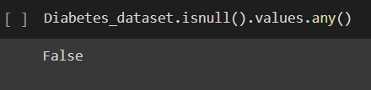
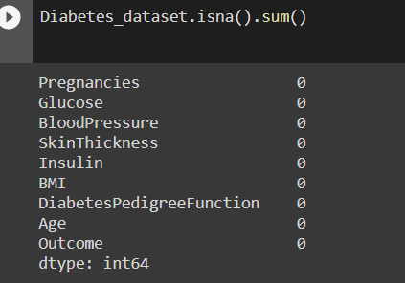
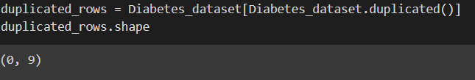
Counting null values :
Isnull ()
Isnull().vslues.any()
Isna().sum()
checking for duplicate rows

Slide 8
CORRELATION MATRIX
Correlation is an indication about the changes between two variables
corr ()
- 1 negative correlations
+1 positive correlations

Slide 9

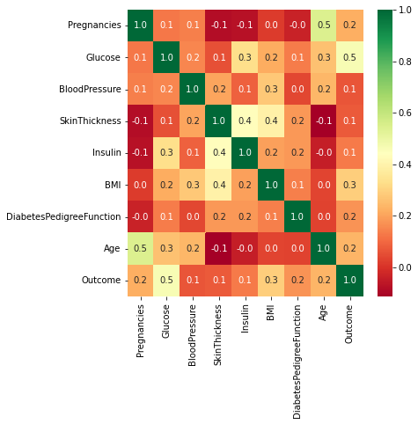
From the correlation matrix we found that
Glucose, BMI, Age, Pregnancies are the top 4 features that are related to the outcome.

Slide 10
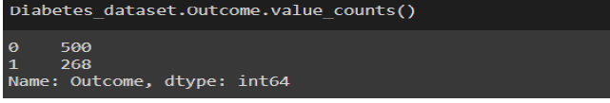
Outcome
In the outcome column ,
1 – positive
0 - represents diabetes negative

Slide 11
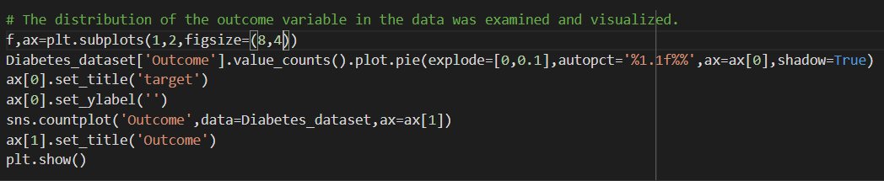
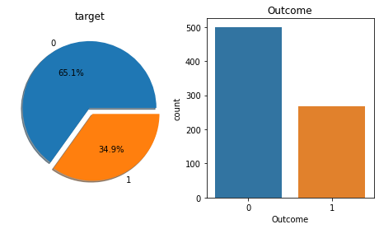
Count plot specifying the number of people suffering by diabetes

Slide 12
DATA PRE – PROCESSING
Data Preprocessing is a technique that is used to convert the raw data into a clean data set.
It makes suitable for a machine learning model which also increases the accuracy and efficiency
to impute or replace missing values with mean, median and mode in one or more numeric feature columns of Pandas DataFrame
STEPS INVOLVED :
Getting the dataset
Importing libraries
Importing datasets
Finding Missing Data
Encoding Categorical Data
Splitting dataset into training and test set
Feature scaling
WAYS TO HANDLE MISSING DATA :
By deleting the particular row: just delete the specific row or column which consists of null values.
By calculating the mean (or ) median : In this way, we will calculate the mean , median of that column or row which contains any missing value and will put it on the place of missing value.

Slide 13
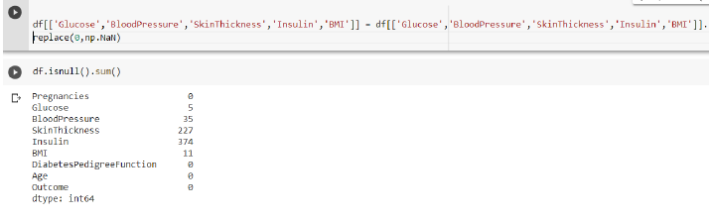
Missing observation analysis
Dataset name is replaced with df
0 is replaced with NaN
counting the null values :
df.isnull().sum() prints the column with missing value. The missing values in the column can be replaced using the following techniques:
Mean values,Median value , mode , constant values

Slide 14

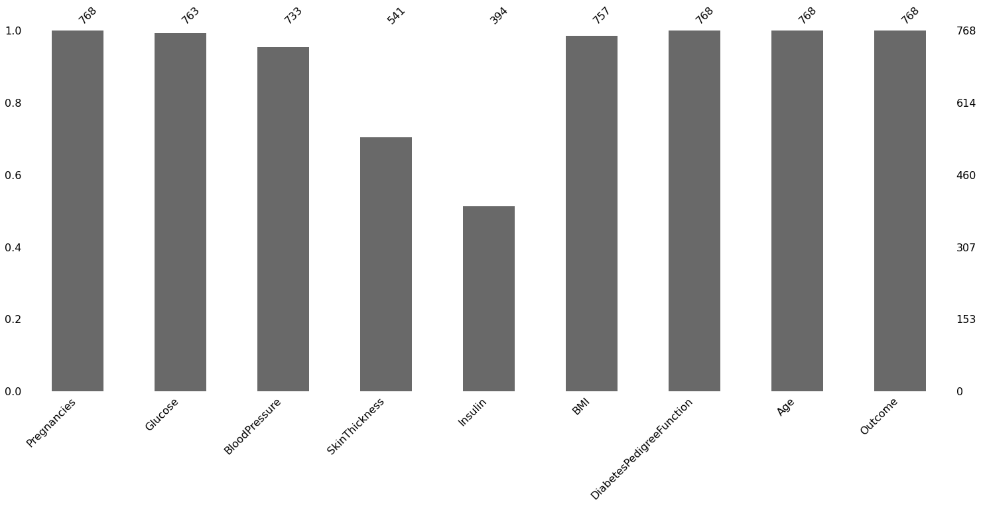
Have been visualized using the missingno library for the visualization of missing observations.

Slide 15

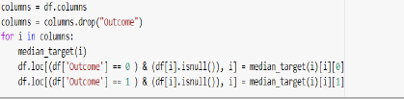
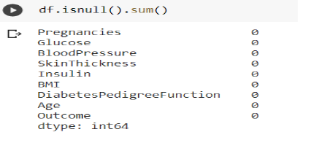
The missing values will be filled with the median values of each variable
The values to be given for incomplete observations are given the median value of people who are not sick and who are sick.
Result :
Statistical summary :

Slide 16
FEATURE SCALING
Feature Scaling is a technique to standardize the independent features present in the data in a fixed range. It is performed during the data pre-processing to handle highly varying magnitudes or values or units
Package Used: sklearn.preprocessing
The most commonly used feature scaling techniques.
Absolute Maximum Scaling.
Min-Max Scaling.
Normalization.
Standardization.
Robust Scaling.

Slide 17
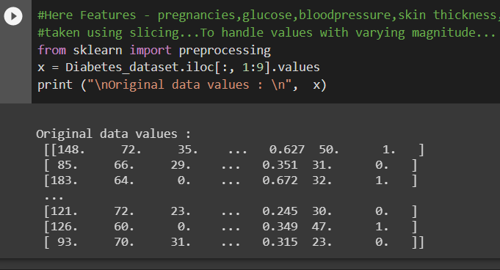
Techniques to perform Feature Scaling Min-Max Normalization: This technique re-scales a feature or observation value with distribution value between 0 and 1. Standardization:Standardization is another scaling technique where the values are centered around the mean with a unit standard deviation. This means that the mean of the attribute becomes zero and the resultant distribution has a unit standard deviation.
Features - pregnancies, glucose, bloodpressure, skin thickness, insulin,BMI,diabetes pedigree function,age,outcome
columns are taken using slicing...To handle values with varying magnitude..

Slide 18


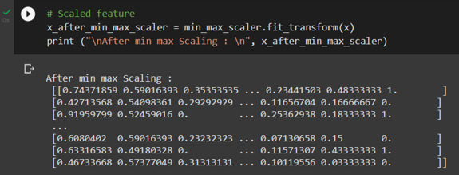
Min-Max Scaling:
It is also referred to as Normalization. The features are scaled between 0 and 1. Here, the mean value remains same as in Standardization,
The formula is given as:
Library used: MinMaxScaler
Fit the scaler using available training data.. This is done by calling the fit() function.
Apply the scale to training data. This is done by calling the transform() function.
Apply the scale to data going forward. : use to make predictions.

Slide 19
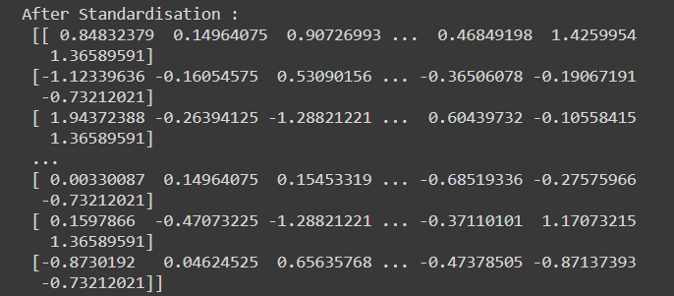
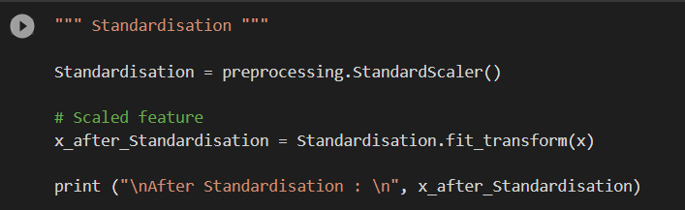
Standardization
To calculate the statistical mean and standard deviation of the attribute values, subtract the mean from each value, and divide the result by the standard deviation
Subtracting the mean from the data is called centering, whereas dividing by the standard deviation is called scaling. The method is sometime called “center scaling“
scaler is defined, fit on the whole dataset and then used to create a transformed version of the dataset with each column standardized independently.The mean value in each column is assigned a value of 0.0 if present and the values are centered around 0.0 with values both positive and negative
Library used: StandardScalar
Both normalization and standardization can be achieved using the scikit-learn library.

